Slide 1

Chapter-1
What Is Data Mining?
Data mining refers to extracting or mining knowledge from large amountsof data. The term is actually a misnomer. Thus, data miningshould have been more appropriately named as knowledge mining which emphasis on mining from large amounts of data.
It is the computational process of discovering patterns in large data sets involving methods at the intersection of artificial intelligence, machine learning, statistics, and database systems.
The overall goal of the data mining process is to extract information from a data set and transform it into an understandable structure for further use.
The key properties of data mining are Automatic discovery of patterns Prediction of likely outcomes Creation of actionable information Focus on large datasets and databases
The Scope of Data Mining
Data mining derives its name from the similarities between searching for valuable business information in a large database — for example, finding linked products in gigabytes of store scanner data — and mining a mountain for a vein of valuable ore. Both processes require either sifting through an immense amount of material, or intelligently probing it to find exactly where the value resides. Given databases of sufficient size and quality, data mining technology can generate new business opportunities by providing these capabilities:

Slide 2
Automated prediction of trends and behaviors. Data mining automates the process of finding predictive information in large databases. Questions that traditionally required extensive hands- on analysis can now be answered directly from the data — quickly. A typical example of a predictive problem is targeted marketing. Data mining uses data on past promotional mailings to identify the targets most likely to maximize return on investment in future mailings. Other predictive problems include forecasting bankruptcy and other forms of default, and identifying segments of a population likely to respond similarly to given events.
Automated discovery of previously unknown patterns. Data mining tools sweep through databases and identify previously hidden patterns in one step. An example of pattern discovery is the analysis of retail sales data to identify seemingly unrelated products that are often purchased together. Other pattern discovery problems include detecting fraudulent credit card transactions and identifying anomalous data that could represent data entry keying errors.
1.3 Tasks of Data Mining
Data mining involves six common classes of tasks:
Anomaly detection (Outlier/change/deviation detection) – The identification of unusual data records, that might be interesting or data errors that require further investigation.
Association rule learning (Dependency modelling) – Searches for relationships between variables. For example a supermarket might gather data on customer purchasing habits. Using association rule learning, the supermarket can determine which products are frequently bought together and use this information for marketing purposes. This is sometimes referred to as market basket analysis.
Clustering – is the task of discovering groups and structures in the data that are in some way or another "similar", without using known structures in the data.
Classification – is the task of generalizing known structure to apply to new data. For example, an e-mail program might attempt to classify an e-mail as "legitimate" or as "spam".
Regression – attempts to find a function which models the data with the least error.

Slide 3
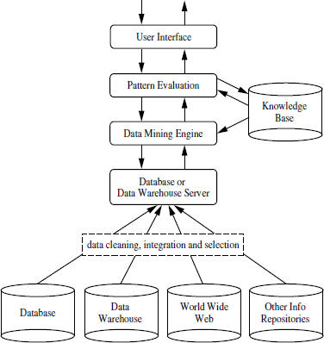
Summarization – providing a more compact representation of the data set, including visualization and report generation.
1.4 Architecture of Data Mining
A typical data mining system may have the following major components.
1. Knowledge Base:
This is the domain knowledge that is used to guide the search orevaluate the interestingness of resulting patterns. Such knowledge can include concepthierarchies,

Slide 4
used to organize attributes or attribute values into different levels of abstraction. Knowledge such as user beliefs, which can be used to assess a pattern’s interestingness based on its unexpectedness, may also be included. Other examples of domain knowledge are additional interestingness constraints or thresholds, and metadata (e.g., describing data from multiple heterogeneous sources).
Data Mining Engine:
This is essential to the data mining systemand ideally consists ofa set of functional modules for tasks such as characterization, association and correlationanalysis, classification, prediction, cluster analysis, outlier analysis, and evolutionanalysis.
Pattern Evaluation Module:
This component typically employs interestingness measures interacts with the data mining modules so as to focus thesearch toward interesting patterns. It may use interestingness thresholds to filterout discovered patterns. Alternatively, the pattern evaluation module may be integratedwith the mining module, depending on the implementation of the datamining method used. For efficient data mining, it is highly recommended to pushthe evaluation of pattern interestingness as deep as possible into the mining processso as to confine the search to only the interesting patterns.
User interface:
Thismodule communicates between users and the data mining system,allowing the user to interact with the system by specifying a data mining query ortask, providing information to help focus the search, and performing exploratory datamining based on the intermediate data mining results. In addition, this componentallows the user to browse database and data warehouse schemas or data structures,evaluate mined patterns, and visualize the patterns in different forms.

Slide 5
Data Mining Process:
Data Mining is a process of discovering various models, summaries, and derived values from a given collection of data.
The general experimental procedure adapted to data-mining problems involves the following steps:
State the problem and formulate the hypothesis
Most data-based modeling studies are performed in a particular application domain. Hence, domain-specific knowledge and experience are usually necessary in order to come up with a meaningful problem statement. Unfortunately, many application studies tend to focus on the data-mining technique at the expense of a clear problem statement. In this step, a modeler usually specifies a set of variables for the unknown dependency and, if possible, a general form of this dependency as an initial hypothesis. There may be several hypotheses formulated for a single problem at this stage. The first step requires the combined expertise of an application domain and a data-mining model. In practice, it usually means a close interaction between the data-mining expert and the application expert. In successful data-mining applications, this cooperation does not stop in the initial phase; it continues during the entire data-mining process.
Collect the data
This step is concerned with how the data are generated and collected. In general, there are two distinct possibilities. The first is when the data-generation process is under the control of an expert (modeler): this approach is known as a designed experiment. The second possibility is when the expert cannot influence the data- generation process: this is known as the observational approach. An observational setting, namely, random data generation, is assumed in most data-mining applications. Typically, the sampling

Slide 6
distribution is completely unknown after data are collected, or it is partially and implicitly given in the data-collection procedure. It is very important, however, to understand how data collection affects its theoretical distribution, since such a priori knowledge can be very useful for modeling and, later, for the final interpretation of results. Also, it is important to make sure that the data used for estimating a model and the data used later for testing and applying a model come from the same, unknown, sampling distribution. If this is not the case, the estimated model cannot be successfully used in a final application of the results.
3. Preprocessing the data
In the observational setting, data are usually "collected" from the existing databses, data warehouses, and data marts. Data preprocessing usually includes at least two common tasks:
1. Outlier detection (and removal) – Outliers are unusual data values that are not consistent with most observations. Commonly, outliers result from measurement errors, coding and recording errors, and, sometimes, are natural, abnormal values. Such nonrepresentative samples can seriously affect the model produced later. There are two strategies for dealing with outliers:
Detect and eventually remove outliers as a part of the preprocessing phase, or
Develop robust modeling methods that are insensitive to outliers.
2. Scaling, encoding, and selecting features – Data preprocessing includes several steps such as variable scaling and different types of encoding. For example, one feature with the range [0, 1] and the other with the range [−100, 1000] will not have the same weights in the applied technique; they will also influence the final data-mining results differently. Therefore, it is recommended to scale them and bring both features to the same weight for further analysis. Also, application-specific encoding methods usually achieve

Slide 7
dimensionality reduction by providing a smaller number of informative features for subsequent data modeling.
These two classes of preprocessing tasks are only illustrative examples of a large spectrum of preprocessing activities in a data-mining process.
Data-preprocessing steps should not be considered completely independent from other data-mining phases. In every iteration of the data-mining process, all activities, together, could define new and improved data sets for subsequent iterations. Generally, a good preprocessing method provides an optimal representation for a data-mining technique by incorporating a priori knowledge in the form of application-specific scaling and encoding.
Estimate the model
The selection and implementation of the appropriate data-mining technique is the main task in this phase. This process is not straightforward; usually, in practice, the implementation is based on several models, and selecting the best one is an additional task. The basic principles of learning and discovery from data are given in Chapter 4 of this book. Later, Chapter 5 through 13 explain and analyze specific techniques that are applied to perform a successful learning process from data and to develop an appropriate model.
Interpret the model and draw conclusions
In most cases, data-mining models should help in decision making. Hence, such models need to be interpretable in order to be useful because humans are not likely to base their decisions on complex "black-box" models. Note that the goals of accuracy of the model and accuracy of its interpretation are somewhat contradictory. Usually, simple models are more interpretable, but they are also less accurate. Modern data-mining methods are expected to yield highly accurate results using highdimensional models. The problem of interpreting these models, also very important, is considered a separate task, with specific

Slide 8
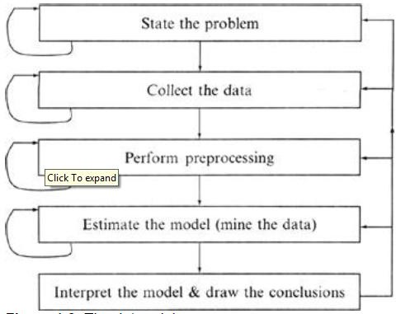

techniques to validate the results. A user does not want hundreds of pages of numeric results. He does not understand them; he cannot summarize, interpret, and use them for successful decision making.
The Data mining Process
1.6 Classification of Data mining Systems:
The data mining system can be classified according to the following criteria: Database Technology
Statistics Machine Learning
Information Science Visualization
Other Disciplines

Slide 9
Some Other Classification Criteria:
Classification according to kind of databases mined Classification according to kind of knowledge mined Classification according to kinds of techniques utilized Classification according to applications adapted
Classification according to kind of databases mined
We can classify the data mining system according to kind of databases mined. Database system can be classified according to different criteria such as data models, types of data etc. And the data mining system can be classified accordingly. For example if we classify the database according to data model then we may have a relational, transactional, object- relational, or data warehouse mining system.
Classification according to kind of knowledge mined
We can classify the data mining system according to kind of knowledge mined. It is means data mining system are classified on the basis of functionalities such as:
Characterization Discrimination
Association and Correlation Analysis Classification
Prediction Clustering Outlier Analysis
Evolution Analysis

Slide 10
Classification according to kinds of techniques utilized
We can classify the data mining system according to kind of techniques used. We can describes these techniques according to degree of user interaction involved or the methods of analysis employed.
Classification according to applications adapted
We can classify the data mining system according to application adapted. These applications are as follows:
Finance Telecommunications DNA
Stock Markets E-mail
1.7 Major Issues In Data Mining:
Mining different kinds of knowledge in databases. - The need of different users is not the same. And Different user may be in interested in different kind of knowledge. Therefore it is necessary for data mining to cover broad range of knowledge discovery task.
Interactive mining of knowledge at multiple levels of abstraction. - The data mining process needs to be interactive because it allows users to focus the search for patterns, providing and refining data mining requests based on returned results.
Incorporation of background knowledge. - To guide discovery process and to express the discovered patterns, the background knowledge can be used. Background knowledge may be used to express the discovered patterns not only in concise terms but at multiple level of abstraction.

Slide 11
Data mining query languages and ad hoc data mining. - Data Mining Query language that allows the user to describe ad hoc mining tasks, should be integrated with a data warehouse query language and optimized for efficient and flexible data mining.
Presentation and visualization of data mining results. - Once the patterns are discovered it needs to be expressed in high level languages, visual representations. This representations should be easily understandable by the users.
Handling noisy or incomplete data. - The data cleaning methods are required that can handle the noise, incomplete objects while mining the data regularities. If data cleaning methods are not there then the accuracy of the discovered patterns will be poor.
Pattern evaluation. - It refers to interestingness of the problem. The patterns discovered should be interesting because either they represent common knowledge or lack novelty.
Efficiency and scalability of data mining algorithms. - In order to effectively extract the information from huge amount of data in databases, data mining algorithm must be efficient and scalable.
Parallel, distributed, and incremental mining algorithms. - The factors such as huge size of databases, wide distribution of data,and complexity of data mining methods motivate the development of parallel and distributed data mining algorithms. These algorithm divide the data into partitions which is further processed parallel. Then the results from the partitions is merged. The incremental algorithms, updates databases without having mine the data again from scratch.
1.8 Knowledge Discovery in Databases(KDD)

Slide 12
Some people treat data mining same as Knowledge discovery while some people view data mining essential step in process of knowledge discovery. Here is the list of steps involved in knowledge discovery process:
Data Cleaning - In this step the noise and inconsistent data is removed.
Data Integration - In this step multiple data sources are combined.
Data Selection - In this step relevant to the analysis task are retrieved from the database.
Data Transformation - In this step data are transformed or consolidated into forms appropriate for mining by performing summary or aggregation operations.
Data Mining - In this step intelligent methods are applied in order to extract data patterns.
Pattern Evaluation - In this step, data patterns are evaluated.
Knowledge Presentation - In this step,knowledge is represented.

Slide 13
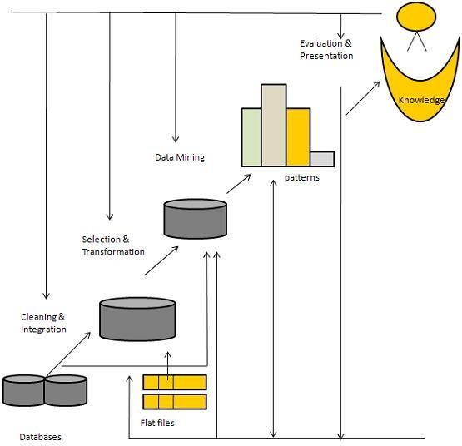
The following diagram shows the process of knowledge discovery process:
Architecture of KDD
1.9 Data Warehouse:
A data warehouse is a subject-oriented, integrated, time-variant and non-volatile collection of data in support of management's decision making process.

Slide 14
Subject-Oriented: A data warehouse can be used to analyze a particular subject area. For example, "sales" can be a particular subject.
Integrated: A data warehouse integrates data from multiple data sources. For example, source A and source B may have different ways of identifying a product, but in a data warehouse, there will be only a single way of identifying a product.
Time-Variant: Historical data is kept in a data warehouse. For example, one can retrieve data from 3 months, 6 months, 12 months, or even older data from a data warehouse. This contrasts with a transactions system, where often only the most recent data is kept. For example, a transaction system may hold the most recent address of a customer, where a data warehouse can hold all addresses associated with a customer.
Non-volatile: Once data is in the data warehouse, it will not change. So, historical data in a data warehouse should never be altered.
1.9.1 Data Warehouse Design Process:
A data warehouse can be built using a top-down approach, a bottom-up approach, or a
combination of both.
The top-down approach starts with the overall design and planning. It is useful in cases where the technology is mature and well known, and where the business problems that must be solved are clear and well understood.
The bottom-up approach starts with experiments and prototypes. This is useful in the early stage of business modeling and technology development. It allows an organization to move forward at considerably less expense and to evaluate the benefits of the technology before making significant commitments.
In the combined approach, an organization can exploit the planned and strategic nature of the top-down approach while retaining the rapid implementation and opportunistic application of the bottom-up approach.

Slide 15
The warehouse design process consists of the following steps:
Choose a business process to model, for example, orders, invoices, shipments, inventory, account administration, sales, or the general ledger. If the business process is organizational and involves multiple complex object collections, a data warehouse model should be followed. However, if the process is departmental and focuses on the analysis of one kind of business process, a data mart model should be chosen.
Choose the grain of the business process. The grain is the fundamental, atomic level of data to be represented in the fact table for this process, for example, individual transactions, individual daily snapshots, and so on.
Choose the dimensions that will apply to each fact table record. Typical dimensions are time, item, customer, supplier, warehouse, transaction type, and status.
Choose the measures that will populate each fact table record. Typical measures are numeric additive quantities like dollars sold and units sold.

Slide 16
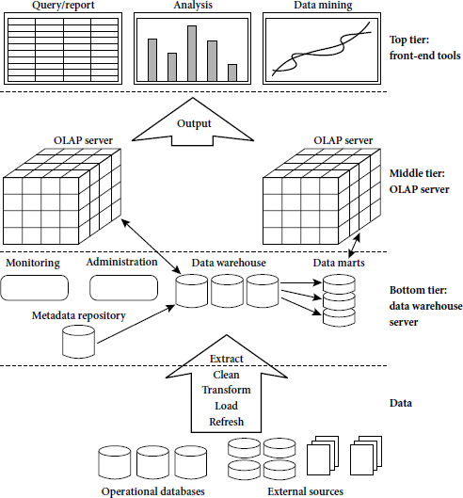
1.9.2 A Three Tier Data Warehouse Architecture:
Tier-1:
The bottom tier is a warehouse database server that is almost always a relationaldatabase system. Back-end tools and utilities are used to feed data into the bottomtier from operational databases or other external sources (such as customer profileinformation provided by external consultants). These tools and utilities performdataextraction, cleaning, and transformation (e.g., to merge similar data from differentsources into a unified format), as well as load and refresh functions to update thedata warehouse . The data are extracted using application programinterfaces known as gateways. A gateway is

Slide 17
supported by the underlying DBMS andallows client programs to generate SQL code to be executed at a server.
Examplesof gateways include ODBC (Open Database Connection) and OLEDB (Open Linkingand Embedding for Databases) by Microsoft and JDBC (Java Database Connection).
This tier also contains a metadata repository, which stores information aboutthe data warehouse and its contents.
Tier-2:
The middle tier is an OLAP server that is typically implemented using either a relational OLAP (ROLAP) model or a multidimensional OLAP.
OLAP model is an extended relational DBMS thatmaps operations on multidimensional data to standard relational operations.
A multidimensional OLAP (MOLAP) model, that is, a special-purpose server that directly implements multidimensional data and operations.
Tier-3:
The top tier is a front-end client layer, which contains query and reporting tools, analysis tools, and/or data mining tools (e.g., trend analysis, prediction, and so on).

Slide 18
1.9.3 Data Warehouse Models:
There are three data warehouse models.
1. Enterprise warehouse:
An enterprise warehouse collects all of the information about subjects spanning the entire organization.
It provides corporate-wide data integration, usually from one or more operational systems or external information providers, and is cross-functional in scope.
It typically contains detailed data aswell as summarized data, and can range in size from a few gigabytes to hundreds of gigabytes, terabytes, or beyond.
An enterprise data warehouse may be implemented on traditional mainframes, computer superservers, or parallel architecture platforms. It requires extensive business modeling and may take years to design and build.
2. Data mart:
A data mart contains a subset of corporate-wide data that is of value to aspecific group of users. The scope is confined to specific selected subjects. For example,a marketing data mart may confine its subjects to customer, item, and sales. Thedata contained in data marts tend to be summarized.
Data marts are usually implemented on low-cost departmental servers that areUNIX/LINUX- or Windows-based. The implementation cycle of a data mart ismore likely to be measured in weeks rather than months or years. However, itmay involve complex integration in the long run if its design and planning werenot enterprise-wide.

Slide 19
Depending on the source of data, data marts can be categorized as independent ordependent. Independent data marts are sourced fromdata captured fromone or moreoperational systems or external information providers, or fromdata generated locallywithin a particular department or geographic area. Dependent data marts are sourceddirectly from enterprise data warehouses.
3. Virtual warehouse:
A virtual warehouse is a set of views over operational databases. Forefficient query processing, only some of the possible summary views may be materialized.
A virtual warehouse is easy to build but requires excess capacity on operational database servers.
1.9.4 Meta Data Repository:
Metadata are data about data.When used in a data warehouse, metadata are the data thatdefine warehouse objects. Metadata are created for the data names anddefinitions of the given warehouse. Additional metadata are created and captured fortimestamping any extracted data, the source of the extracted data, and missing fieldsthat have been added by data cleaning or integration processes.
A metadata repository should contain the following:
A description of the structure of the data warehouse, which includes the warehouse schema, view, dimensions, hierarchies, and derived data definitions, as well as data mart locations and contents.
Operational metadata, which include data lineage (history of migrated data and the sequence of transformations applied to it), currency of data (active, archived, or purged), and monitoring information (warehouse usage statistics, error reports, and audit trails).

Slide 20
The algorithms used for summarization, which include measure and dimension definitionalgorithms, data on granularity, partitions, subject areas, aggregation, summarization,and predefined queries and reports.
The mapping from the operational environment to the data warehouse, which includessource databases and their contents, gateway descriptions, data partitions, data extraction, cleaning, transformation rules and defaults, data refresh and purging rules, andsecurity (user authorization and access control).
Data related to system performance, which include indices and profiles that improvedata access and retrieval performance, in addition to rules for the timing and scheduling of refresh, update, and replication cycles.
Business metadata, which include business terms and definitions, data ownershipinformation, and charging policies.
1.10 OLAP(Online analytical Processing):
OLAP is an approach to answering multi-dimensional analytical (MDA) queries swiftly. OLAP is part of the broader category of business intelligence, which also encompasses relational database, report writing and data mining.
OLAP tools enable users to analyze multidimensional data interactively from multiple perspectives.
OLAP consists of three basic analytical operations:
Consolidation (Roll-Up)
Drill-Down

Slide 21
Slicing And Dicing
Consolidation involves the aggregation of data that can be accumulated and computed in one or more dimensions. For example, all sales offices are rolled up to the sales department or sales division to anticipate sales trends.
The drill-down is a technique that allows users to navigate through the details. For instance, users can view the sales by individual products that make up a region’s sales.
Slicing and dicing is a feature whereby users can take out (slicing) a specific set of data of the OLAP cube and view (dicing) the slices from different viewpoints.
Types of OLAP:
Relational OLAP (ROLAP):
ROLAP works directly with relational databases. The base data and the dimension tables are stored as relational tables and new tables are created to hold the aggregated information. It depends on a specialized schema design.
This methodology relies on manipulating the data stored in the relational database to give the appearance of traditional OLAP's slicing and dicing functionality. In essence, each action of slicing and dicing is equivalent to adding a "WHERE" clause in the SQL statement.
ROLAP tools do not use pre-calculated data cubes but instead pose the query to the standard relational database and its tables in order to bring back the data required to answer the question.
ROLAP tools feature the ability to ask any question because the methodology does not limit to the contents of a cube. ROLAP also has the ability to drill down to the lowest level of detail in the database.

Slide 22
Multidimensional OLAP (MOLAP):
MOLAP is the 'classic' form of OLAP and is sometimes referred to as just OLAP.
MOLAP stores this data in an optimized multi-dimensional array storage, rather than in a relational database. Therefore it requires the pre-computation and storage of information in the cube - the operation known as processing.
MOLAP tools generally utilize a pre-calculated data set referred to as a data cube. The data cube contains all the possible answers to a given range of questions.
MOLAP tools have a very fast response time and the ability to quickly write back data into the data set.
Hybrid OLAP (HOLAP):
There is no clear agreement across the industry as to what constitutes Hybrid OLAP, except that a database will divide data between relational and specialized storage.
For example, for some vendors, a HOLAP database will use relational tables to hold the larger quantities of detailed data, and use specialized storage for at least some aspects of the smaller quantities of more-aggregate or less-detailed data.
HOLAP addresses the shortcomings of MOLAP and ROLAP by combining the capabilities of both approaches.
HOLAP tools can utilize both pre-calculated cubes and relational data sources.

Slide 23
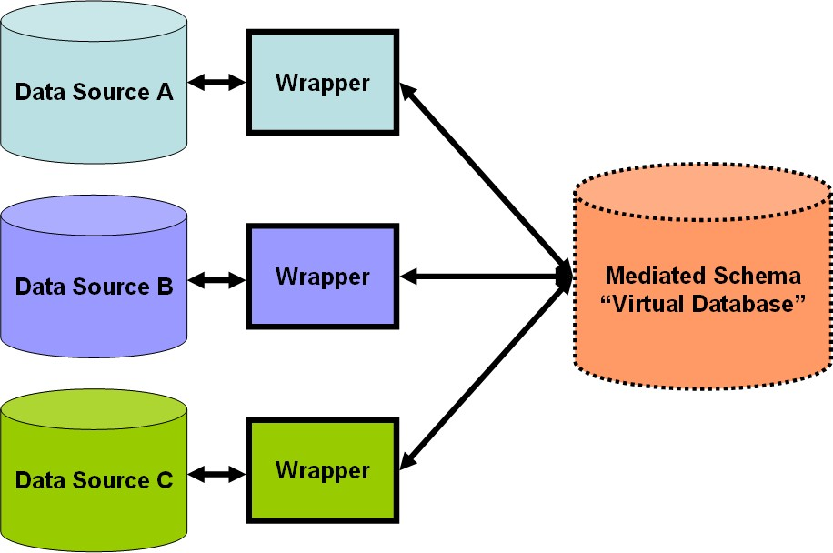
Data Preprocessing:
Data Integration:
It combines datafrom multiple sources into a coherent data store, as in data warehousing. These sourcesmay include multiple databases, data cubes, or flat files.
The data integration systems are formally defined as triple<G,S,M> Where G: The global schema
S:Heterogeneous source of schemas
M: Mapping between the queries of source and global schema

Slide 24
Issues in Data integration:
Schema integration and object matching:
How can the data analyst or the computer be sure that customer id in one database and customer number in another reference to the same attribute.
Redundancy:
An attribute (such as annual revenue, forinstance) may be redundant if it can be derived from another attribute or set ofattributes. Inconsistencies in attribute or dimension naming can also cause redundanciesin the resulting data set.
detection and resolution of datavalue conflicts:
For the same real-world entity, attribute values fromdifferent sources may differ.
1.11.3 Data Transformation:
In data transformation, the data are transformed or consolidated into forms appropriatefor mining.
Data transformation can involve the following:
Smoothing, which works to remove noise from the data. Such techniques includebinning, regression, and clustering.
Aggregation, where summary or aggregation operations are applied to the data. For example, the daily sales data may be aggregated so as to compute monthly and annualtotal amounts. This step is typically used in constructing a data cube for analysis of the data at multiple granularities.

Slide 25
Generalization of the data, where low-level or ―primitive‖ (raw) data are replaced byhigher-level concepts through the use of concept hierarchies. For example, categoricalattributes, like street, can be generalized to higher-level concepts, like city or country.
Normalization, where the attribute data are scaled so as to fall within a small specifiedrange, such as 1:0 to 1:0, or 0:0 to 1:0.
Attribute construction (or feature construction),wherenewattributes are constructedand added from the given set of attributes to help the mining process.
1.11.4 Data Reduction:
Data reduction techniques can be applied to obtain a reduced representation of thedata set that ismuch smaller in volume, yet closely maintains the integrity of the originaldata. That is, mining on the reduced data set should be more efficient yet produce thesame (or almost the same) analytical results.
Strategies for data reduction include the following:
Data cube aggregation, where aggregation operations are applied to the data in theconstruction of a data cube.
Attribute subset selection, where irrelevant, weakly relevant, or redundant attributesor dimensions may be detected and removed.
Dimensionality reduction, where encoding mechanisms are used to reduce the dataset size.
Numerosityreduction,where the data are replaced or estimated by alternative, smallerdata representations such as parametric models (which need store only the modelparameters instead of the actual data) or nonparametric methods such as clustering,sampling, and the use of histograms.
Discretization and concept hierarchy generation,where rawdata values for attributesare replaced by ranges or higher conceptual levels. Data discretization is a form ofnumerosity reduction that is very useful for the automatic generation of concept hierarchies.Discretization and concept hierarchy generation are powerful tools for datamining, in that they allow the mining of data at multiple levels of abstraction.

